Slide 1


Audience Segmentation Research Retail Customers Internal Team Review August 2, 2017

Slide 2
Research Objectives
Evaluate all audience segments by media target definition
Discover insights into media preference, usage and behavior
Provide strategy and creative teams with lifestyle beliefs and attitudes (relevant)
Discover shopping habits, behavior and attitudes
Overlay ABC branded and spirit category social media environment (Authentic)

Slide 3
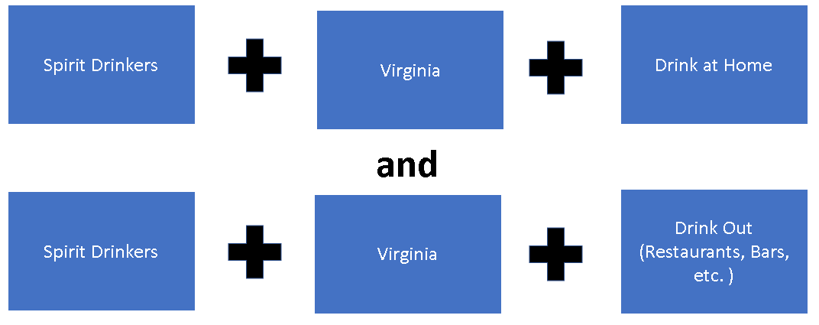
Methodology – Step I

Slide 4
Findings
Most favorable target within this segment is the group who drink at home and buy spirits from VA ABC. We were looking for differences in demographics, shopping and personality behaviors to better target the messaging.
There are some differences in age demographics. Younger age groups 22—34 are more likely to drink at home. Some of this may be due to their preferred activities and not as much disposable income
While the demographics of these two were different the Shopping Attitudes and insights were very similar
* Indicates sample size was too small and data may not be stable
Note that a high percentage of 21-29 have a high HHI – This is due to living with their parents.

Slide 5
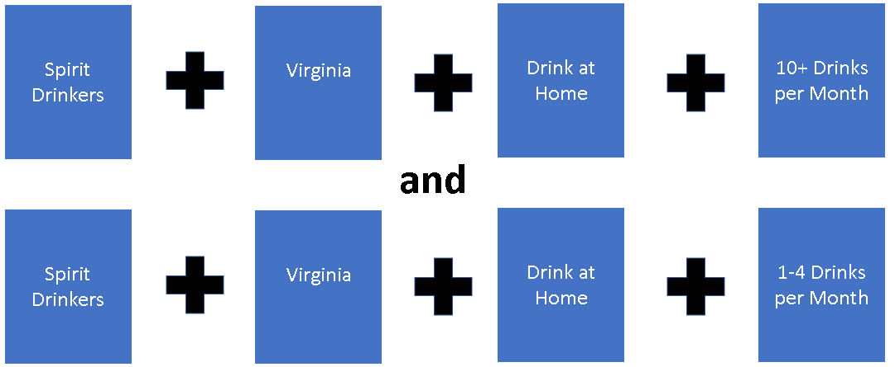
Methodology Step 2

Slide 6
Findings
The next step was to determine if those who drink at home 1-4 times a month have different behaviors and demographics then those that drink 10+ times a month.
We found almost zero difference in demographics and behaviors between those who drink at home 1-4 times a month or 10+ times a month.
Statistically, there are no significant relevant differences.

Slide 7
Methodology – Step 3
There are few behavioral or attitude differences between those who drink at home or out as well as those who drink 10 or more drinks a month and those who drink 1-4 a month.
There are some demographic differences between those that drink at home or drink out.
Because the differences seem to center around demographics our next step was to break down spirit drinkers age demographics by 5 year demo cells.

Slide 8
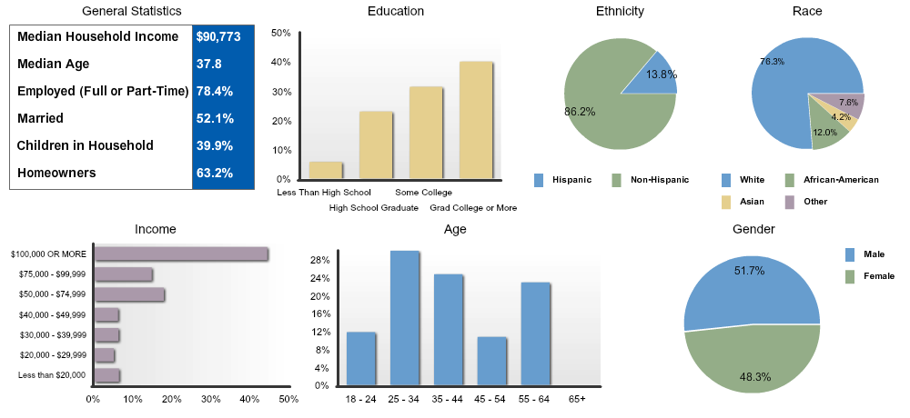
All Spirit Drinkers
Demographics

Slide 9
Methodology – Step 3
Spirit Drinkers into 5 year Increments
Grouped increments into similar behaviors and attitudes
Discovered 4 Audiences

Slide 10
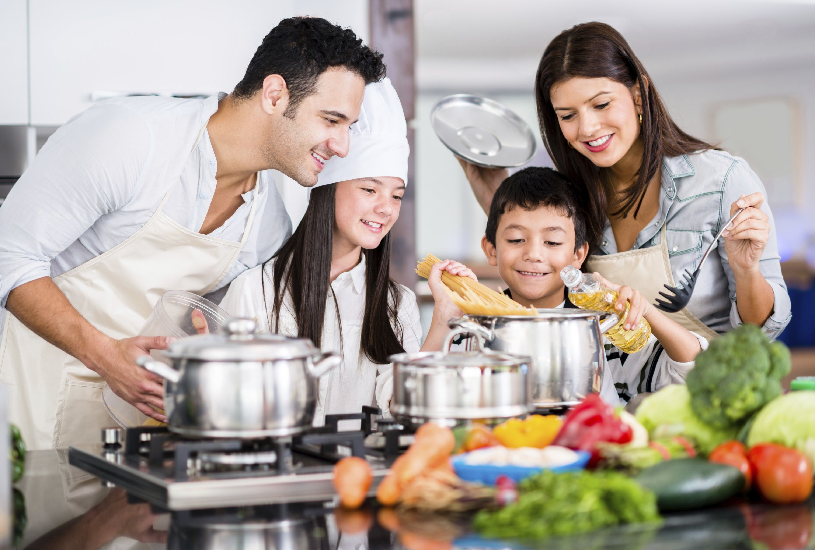
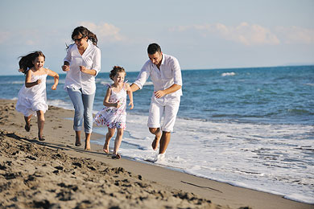


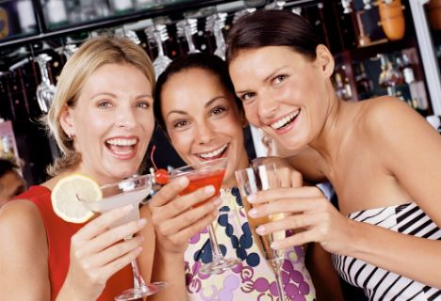
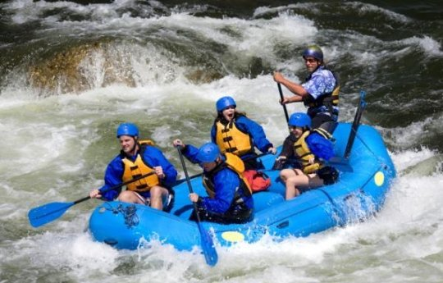
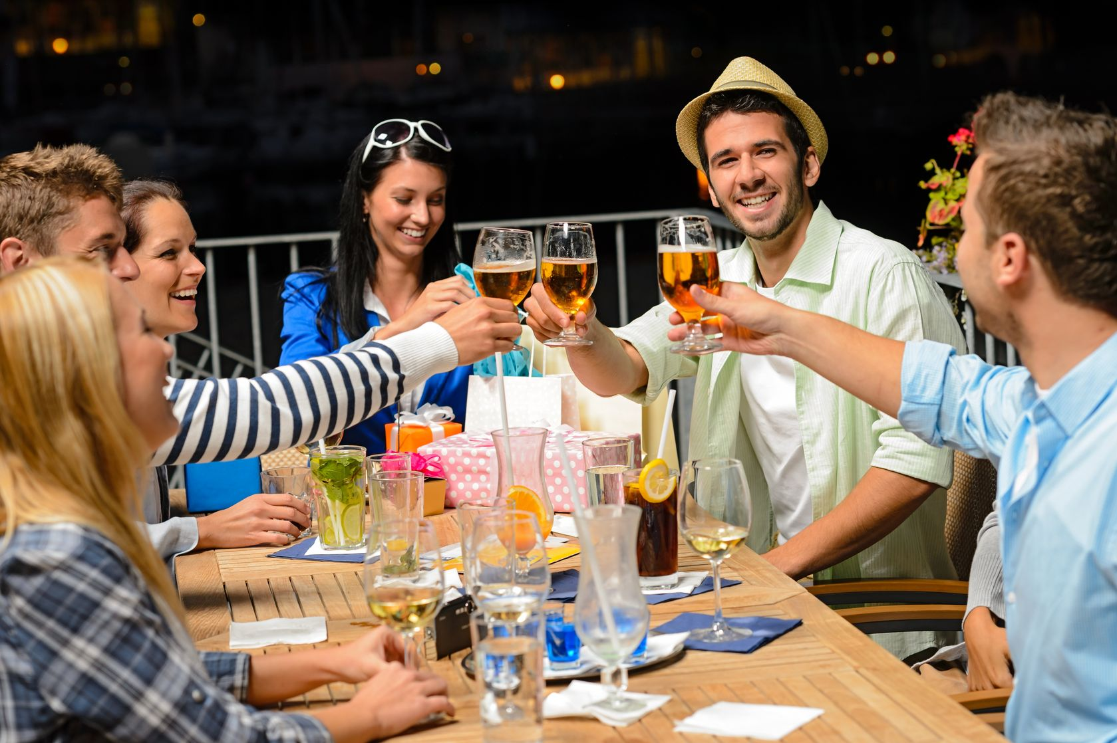
Adults/30-39 28.8% of spirit drinkers
Primary Target Audience
10

Slide 11
Primary Audience: Adults 30-39
Key Findings: 30-39 is your greatest opportunity to:
increase transaction value
increase share of glass
The largest group of spirit consumers
Not yet brand loyal
Most engaged in social media (more than 21-29)
Beginning to have a disposable income

Slide 12
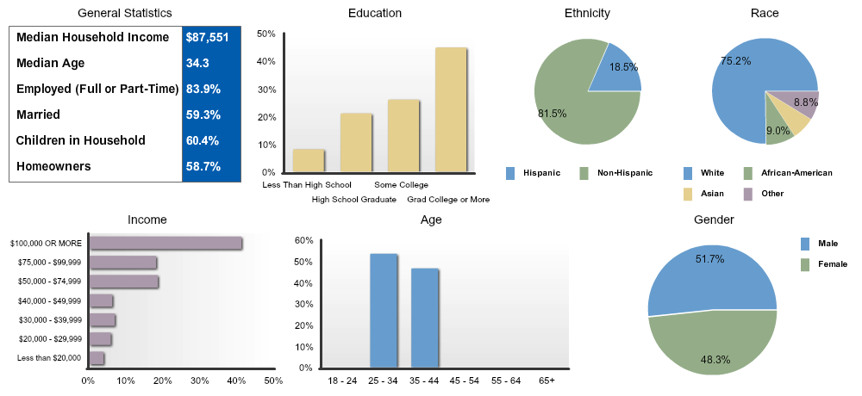
Primary Audience: Adults 30-39
Demographics
Notes:
This group is going to be your primary target
They are social connectors, they are in the space and are engaged
They have a higher HHI but are influential buyers. They’re not as loyal to brands as those in older deomgraphics.
They’re risk takers so willing to change habits
They are also your largest group of Spirit drinkers.

Slide 13
Messaging Insights– Who They Are
Primary Audience: Adults 30-39
Primary audiences is adventurous and sees themselves as good-hearted, well informed, comfortable in their own skin
 | Spirit Drinkers 30-39 Index | Spirit Drinkers 30-39 Vertical Percent
ATTITUDES (GENERAL) - AGREE A LOT: I AM AN OPTIMIST | 104 | 24.9%
ATTITUDES (SOCIAL INTRCTION)-AGREE A LOT: I AM NOT AFRAID TO APPEAR UNCONVENTIONAL | 112 | 21.0%
ATTITUDES (SOCIAL INTRCTION)-AGREE A LOT: I AM ADVENTUROUS | 124 | 20.1%
SELF-CONCEPTS - AGREE A LOT: KIND, GOOD-HEARTED, WARMHEARTED, SINCERE | 108 | 48.8%
SELF-CONCEPTS - AGREE A LOT: AFFECTIONATE, PASSIONATE, LOVING, ROMANTIC | 106 | 34.6%
SELF-CONCEPTS - AGREE A LOT: INTELLIGENT, SMART, BRIGHT, WELL-INFORMED | 125 | 37.1%
SELF-CONCEPTS - AGREE A LOT: SOCIABLE, FRIENDLY, CHEERFUL, LIKEABLE | 104 | 32.9%
Notes:
Add a word burst with who they are

Slide 14
Messaging - Priorities & Future
Primary Audience: Adults 30-39
 | Spirit Drinkers 30-39 Index | Spirit Drinkers 30-39 Vertical Percent
ATTITUDES (GENERAL) - AGREE A LOT: I ENJOY SPENDING TIME WITH MY FAMILY | 104 | 66.3%
ATTITUDES (GENERAL) - AGREE A LOT: I WANT TO GET TO THE VERY TOP IN MY CAREER | 142 | 21.3%
ATTITUDES (GENERAL) - AGREE A LOT: I WOULD LIKE TO SET UP MY OWN BUSINESS ONE DAY | 141 | 25.1%
ATTITUDES (GENERAL) - AGREE A LOT: IT IS IMPORTANT MY FAMILY THINKS I AM DOING WELL | 108 | 20.6%
ATTITUDES (GENERAL) - AGREE A LOT: I LOOK AT THE WORK I DO AS A CAREER RATHER THAN JUST AS A JOB | 124 | 26.7%
ATTITUDES (GENERAL) - AGREE A LOT: IT IS IMPORTANT TO CONTINUE LEARNING NEW THINGS THROUGHOUT YOUR LIFE | 104 | 58.9%
ATTITUDES (GENERAL) - AGREE A LOT: IT IS IMPORTANT TO BE WELL-INFORMED ABOUT THINGS | 101 | 42.2%
ATTITUDES (SOCIAL INTRCTION)-AGREE A LOT: I LIKE TO SHARE MY KNOWLEDGE WITH OTHERS | 108 | 26.0%
ATTITUDES (SOCIAL INTRCTION)-AGREE A LOT: I LIKE TO LEARN ABOUT THINGS, EVEN IF THEY DO NOT SEEM RELEVANT AT THE TIME | 114 | 31.9%
Primary audiences is career focused, hopeful for the future, wants to be and stay educated

Slide 15
Primary Audience: Adults 30-39
Messaging - What They Like To Do
Notice Agree A lot responses on a 5-point scale.
All of these values are well above average.
 | Spirit Drinkers 30-39 Index | Spirit Drinkers 30-39 Vertical Percent
ATTITUDES (TRAVEL) - AGREE A LOT: I LOVE THE IDEA OF TRAVELING ABROAD | 142 | 32.4%
LEISURE ACTIVITIES/HOBBIES-LAST 12 MOS: BARBECUING | 134 | 52.4%
LEISURE ACTIVITIES/HOBBIES-LAST 12 MOS: BOARD GAMES | 154 | 47.4%
LEISURE ACTIVITIES/HOBBIES-LAST 12 MOS: CARD GAMES | 137 | 51.0%
LEISURE ACTIVITIES/HOBBIES-LAST 12 MOS: GO TO A BEACH/LAKE | 141 | 56.7%
ATTITUDES (GENERAL) - AGREE A LOT: I ENJOY ENTERTAINING PEOPLE IN MY HOME | 125 | 27.9%
ATTITUDES (SOCIAL INTRCTION)-AGREE A LOT: I ENJOY KEEPING IN TOUCH WITH MY FRIENDS AND ACQUAINTANCES | 102 | 36.6%

Slide 16
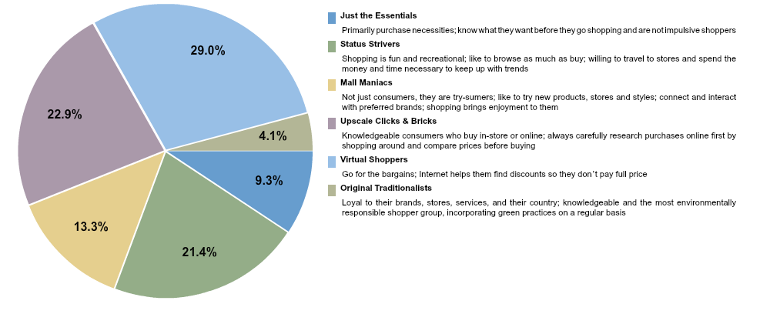
Primary Audience: Adults 30-39
Shopping Attitudes
Small percentages of Just the Essentials and Traditionalists – this is good.

Slide 17
Primary Audience: Adults 30-39
Shopping Attitudes
 | Spirit Drinkers 30-39 Index | Spirit Drinkers 30-39 Vertical Percent
ATTITUDES (ABOUT SHOPPING)- AGREE A LOT: A STORE’S ENVIRONMENT CAN MAKE A DIFFERENCE IN WHETHER I SHOP THERE | 111 | 35.3%
ATTITUDES (ABOUT SHOPPING)- AGREE A LOT: I AM USUALLY WILLING TO SHOP AT NEW STORES | 108 | 14.4%
ATTITUDES (ABOUT SHOPPING)- AGREE A LOT: I OFTEN USE THE INTERNET TO HELP PLAN MY SHOPPING TRIPS | 144 | 14.7%
SHOP BEHAVIOR- AGREE A LOT: I SHOP AROUND A LOT TO TAKE ADVANTAGE OF SPECIALS OR BARGAINS | 108 | 21.8%
SHOP BEHAVIOR- AGREE A LOT: I ALWAYS LOOK OUT FOR SPECIAL OFFERS | 112 | 23.6%
SHOPPING-REFER ALWAYS: DEPARTMENTAL SIGNS/OVRHEAD AISLE MARKERS | 113 | 21.3%
SHOPPING-REFER ALWAYS: FREE STANDING DISPLAYS WITH PRODUCT | 118 | 12.4%
SHOPPING-REFER ALWAYS: SIGNS ON MERCHANDISE RACKS OR SHELVES | 106 | 14.1%
Speaks to the potential value of the instore branding ideas

Slide 18
Primary Audience: Adults 30-39
Brand Loyalty
 | Spirit Drinkers 30-39 Index | Spirit Drinkers 30-39 Vertical Percent
ATTITUDES(ABOUT SHOPPING)- ANY DISAGREE: REGARDLESS OF PRICE, IT IS IMPORTANT TO HAVE THE BRAND I LIKE | 103 | 35.2%
SHOP BEHAVIOR-ANY AGREE: I BUY UNKNOWN BRANDS TO SAVE MONEY | 121 | 37.2%
SHOP BEHAVIOR-ANY DISAGREE: I ALWAYS LOOK FOR THE BRAND NAME ON THE PACKAGE | 103 | 31.2%
SHOP BEHAVIOR-ANY AGREE: WHEN IN THE STORE, I OFTEN BUY AN ITEM ON THE SPUR OF THE MOMENT | 114 | 43.0%
SHOP BEHAVIOR-ANY AGREE: I LIKE TO CHANGE BRANDS OFTEN FOR THE SAKE OF VARIETY AND NOVELTY | 130 | 24.2%
Not loyal to brands yet. This is also good for upsell opportunities.

Slide 19
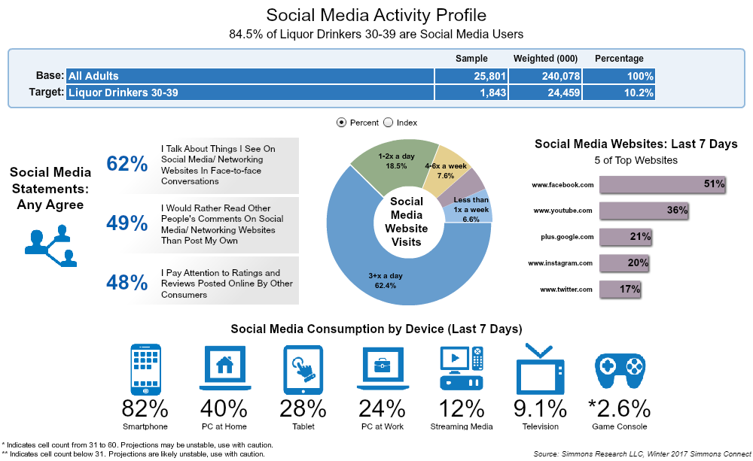
Primary Audience: Adults 30-39
Social Media Profile
Extraordinarily high percentages of social media frequency AND engagement online.

Slide 20
Social Media
Primary Audience: Adults 30-39
 | Spirit Drinkers 30-39 Index | Spirit Drinkers 30-39 Vertical Percent
ATTITUDES (SOCIAL MEDIA) - AGREE A LOT: I TALK ABOUT THINGS I SEE ON SOCIAL MEDIA/ NETWORKING WEBSITES IN FACE-TO-FACE CONVERSATIONS | 176 | 25.7%
ATTITUDES (SOCIAL MEDIA) - AGREE A LOT: I OFTEN ACCESS SOCIAL MEDIA/ NETWORKING WEBSITES FROM DIFFERENT DEVICES | 175 | 16.3%
ATTITUDES (SOCIAL MEDIA) - AGREE A LOT: I OFTEN POST OR COMMENT ON SOCIAL MEDIA/ NETWORKING WEBSITES | 189 | 13.2%
ATTITUDES (SOCIAL MEDIA) - AGREE A LOT: I PAY ATTENTION TO RATINGS AND REVIEWS POSTED ONLINE BY OTHER CONSUMERS | 178 | 15.6%
We can definitely identify social influencers from the segment.

Slide 21
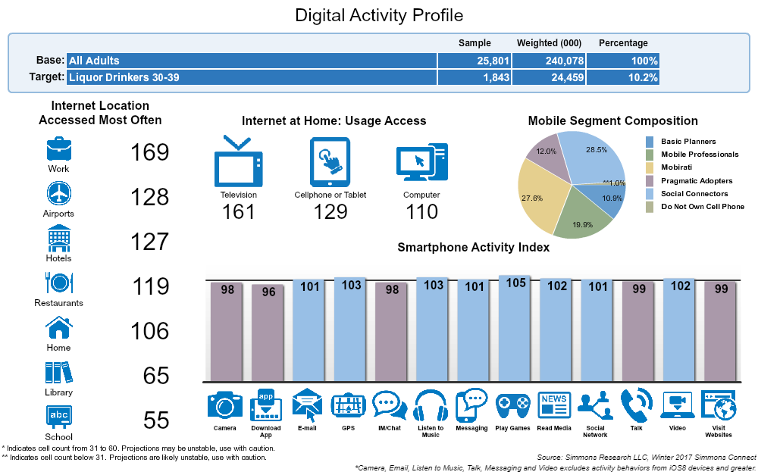
Primary Audience: Adults 30-39
Digital Activity
Social Connectors: Communication is central in their lives; cell phones allow them to keep up to date with friends and social events and serve as the bridge to their social world.
Mobirati:
Represent the mobile generation; grew up with cell phones and can’t imagine life without them; cell phone are a central part of their everyday life.

Slide 22
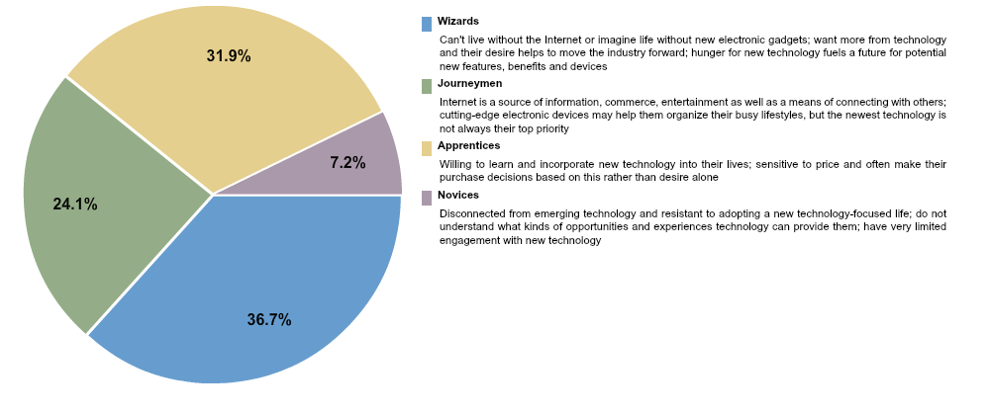
Primary Audience: Adults 30-39
Technology Adaptation
High % of Wizards and Journeymen – ads to the social sharing likelihood.

Slide 23
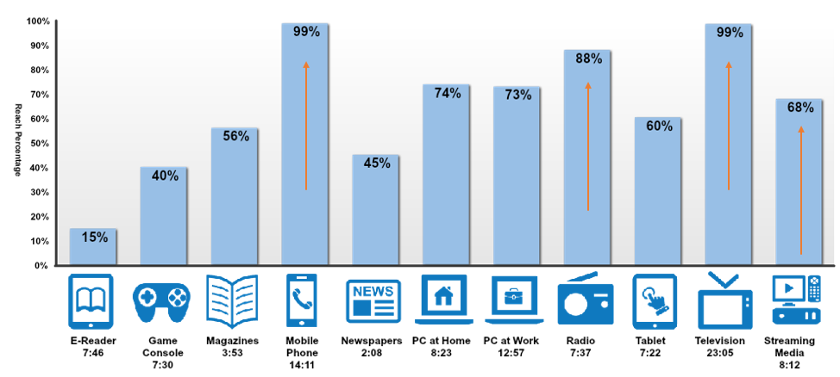
Primary Audience: Adults 30-39
Reach by Channel
Each channel will be broken down by device usage. EX. How much of TV is live viewing vs recorded, etc.

Slide 24
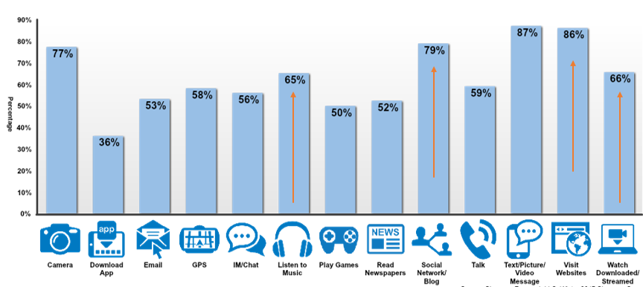
Primary Audience: Adults 30-39
Example: How do they use Smartphone?
Multiple executions possible with this device. Media planning will also determine day of week, time of day for these activities.

Slide 25
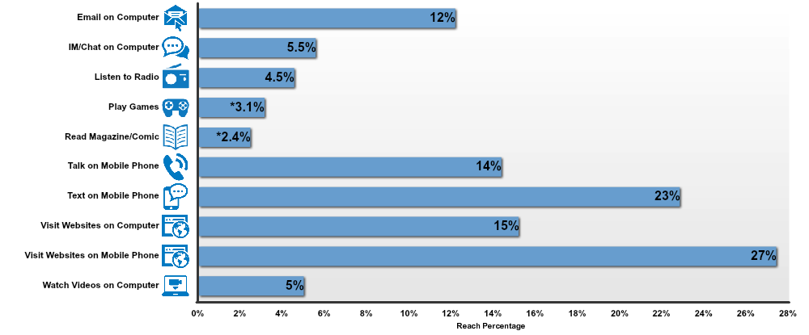
Primary Audience: Adults 30-39
Activity While Watching TV
Heavy device multi-taskers.
Evidence of need for cross platform campaigns.

Slide 26
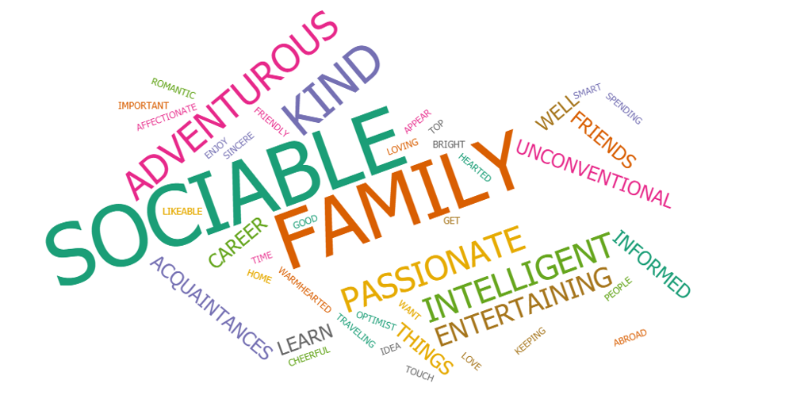
Primary Audience: Adults 30-39
Life stage: starting families, heavy in social scene to stay connected
Sentiment is in the spirit of “spirits” – willing to try new things – life is adventurous

Slide 27

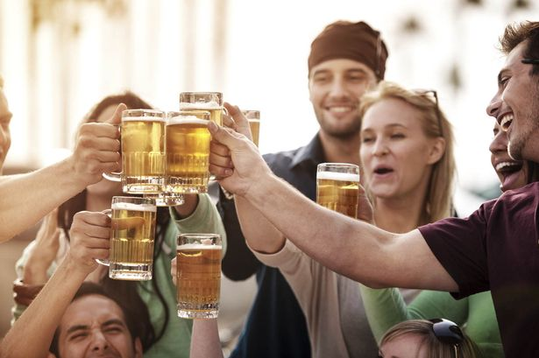
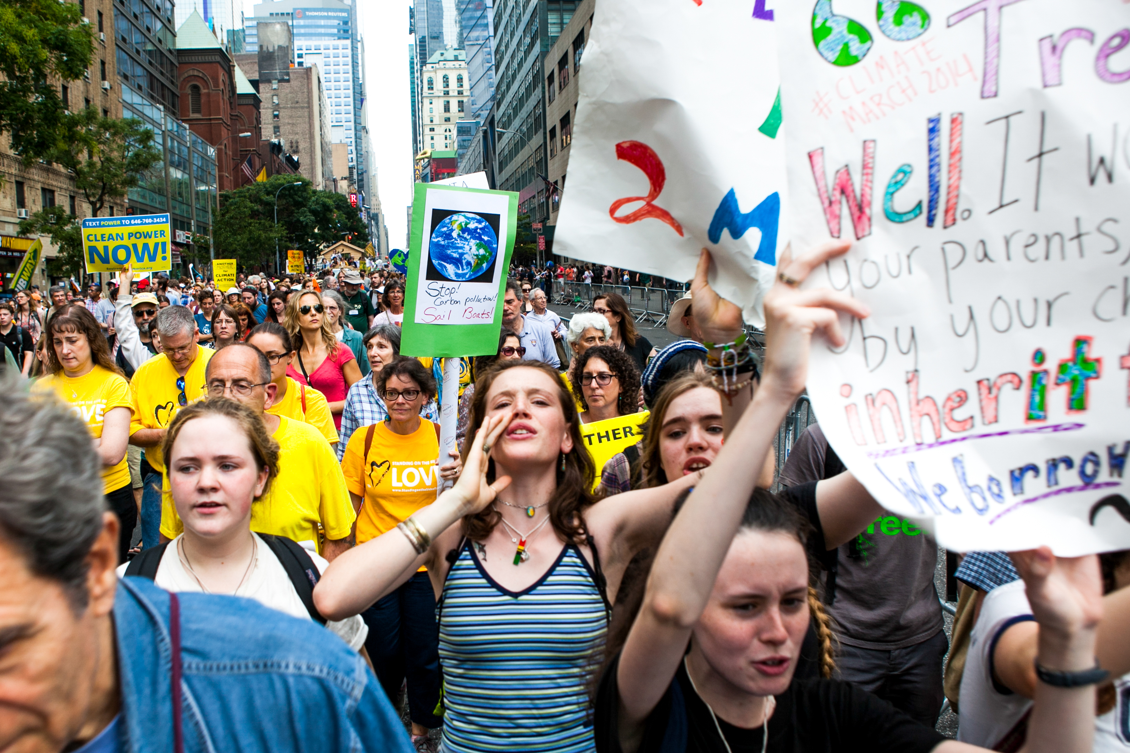
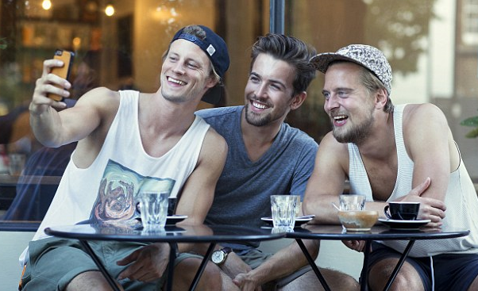
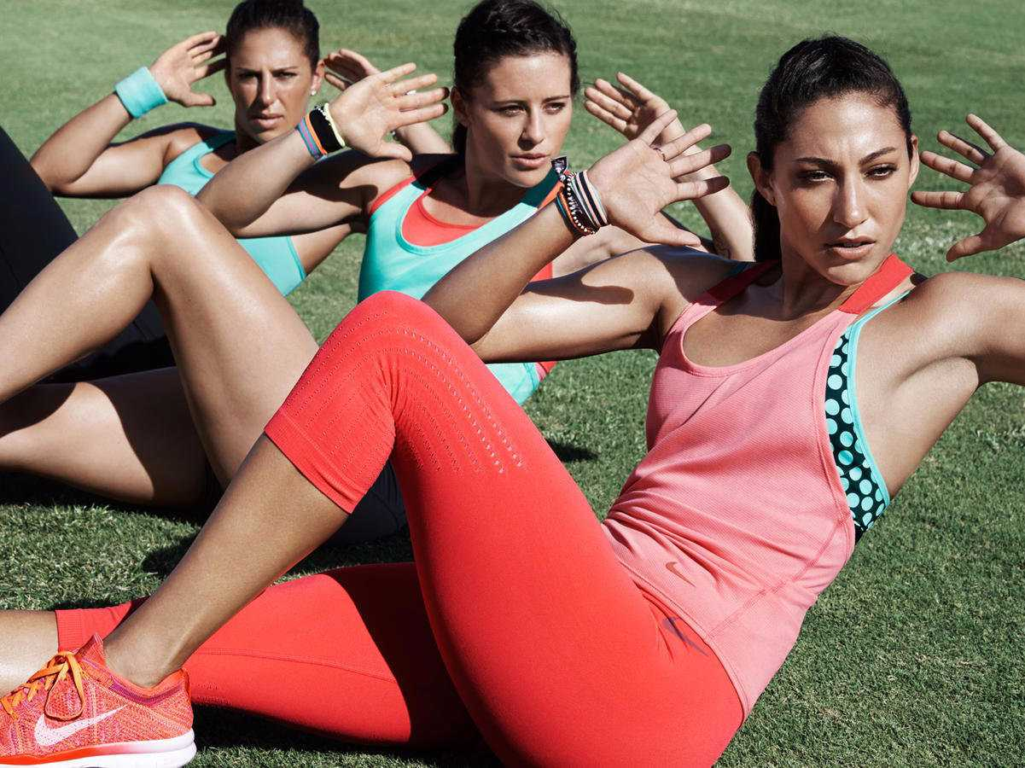
Adults/21-29 25.3% of spirit drinkers
“Persuadable” Audience

Slide 28
Persuadable Audience: Adults 21-29
Key Findings: 21-29 will help increase share of glass if we engage them now, while they are young.
They are not brand loyal
They like to drink at home
Have little disposable income

Slide 29
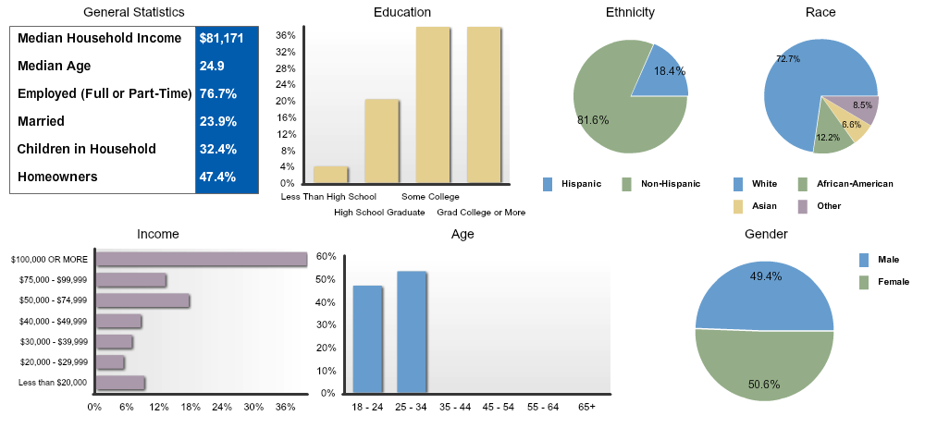
Persuadable Audience: Adults 21-29
Demographics

Slide 30
Messaging – Who They Are
Persuadable Audience: Adults 21-29
 | Persuadable Audience Adults 21-29 Index | Persuadable Audience Adults 21-29 Vertical Percent
SELF-CONCEPTS - AGREE A LOT: AFFECTIONATE, PASSIONATE, LOVING, ROMANTIC | 115 | 37.4%
SELF-CONCEPTS - AGREE A LOT: BRAVE, COURAGEOUS, DARING, ADVENTURESOME | 117 | 21.1%
ATTITUDES (GENERAL) - AGREE A LOT: I ENJOY TAKING RISKS | 191 | 15.0%
ATTITUDES (GENERAL) - AGREE A LOT: I AM A PERFECTIONIST | 111 | 16.4%
ATTITUDES (GENERAL) - AGREE A LOT: I CONSIDER MYSELF TO BE A CREATIVE PERSON | 103 | 27.5%
ATTITUDES (SOCIAL INTRCTION)-AGREE A LOT: I AM NOT AFRAID TO APPEAR UNCONVENTIONAL | 113 | 21.2%
ATTITUDES (SOCIAL INTRCTION)-AGREE A LOT: I AM ADVENTUROUS | 153 | 24.7%
ATTITUDES (SOCIAL INTRCTION)-AGREE A LOT: I HAVE MANY ACQUAINTANCES FROM ALL WALKS OF LIFE | 115 | 28.5%
SELF-CONCEPTS - AGREE A LOT: BROAD-MINDED, OPEN-MINDED, LIBERAL, TOLERANT | 121 | 31.4%
SELF-CONCEPTS - AGREE A LOT: CREATIVE, INVENTIVE, IMAGINATIVE, ARTISTIC | 123 | 29.5%
ATTITUDES (GENERAL) - AGREE A LOT: I MAKE AN EFFORT TO LOOK ATTRACTIVE TO PEOPLE I AM INTERESTED IN | 128 | 20.5%
SELF-CONCEPTS - AGREE A LOT: FUNNY, HUMOROUS, AMUSING, WITTY | 120 | 30.0%
SELF-CONCEPTS - AGREE A LOT: INTELLIGENT, SMART, BRIGHT, WELL-INFORMED | 116 | 34.4%
Persuadable audience enjoys taking risks and are adventurous. They are not afraid to appear unconventional
Notes:
Add a word burst with who they are

Slide 31
Messaging - Priorities & Future
Persuadable Audience: Adults 21-29
 | Spirit Drinkers 21-29 Index | Spirit Drinkers 21-29 Vertical Percent
ATTITUDES (GENERAL) - AGREE A LOT: I WANT TO GET TO THE VERY TOP IN MY CAREER | 208 | 31.3%
ATTITUDES (GENERAL) - AGREE A LOT: I WOULD LIKE TO SET UP MY OWN BUSINESS ONE DAY | 162 | 28.7%
ATTITUDES (GENERAL) - AGREE A LOT: IT IS IMPORTANT MY FAMILY THINKS I AM DOING WELL | 124 | 23.7%
ATTITUDES (GENERAL) - AGREE A LOT: IT IS IMPORTANT TO CONTINUE LEARNING NEW THINGS THROUGHOUT YOUR LIFE | 102 | 57.9%
ATTITUDES (GENERAL) - AGREE A LOT: I LIKE TO PURSUE A LIFE OF CHALLENGE, NOVELTY AND CHANGE | 133 | 19.8%
ATTITUDES (SOCIAL INTRCTION)-AGREE A LOT: I LIKE TO LEARN ABOUT THINGS, EVEN IF THEY DO NOT SEEM RELEVANT AT THE TIME | 112 | 31.2%
Persuadable audience is focused on their future career and how they want to succeed.

Slide 32
Persuadable Audience: Adults 21-29
Messaging - What They Love To Do
 | Spirit Drinkers 21-29 Index | Spirit Drinkers 21-29 Vertical Percent
ATTITUDES (GENERAL) - AGREE A LOT: MUSIC IS AN IMPORTANT PART OF MY LIFE | 129 | 36.9%
ATTITUDES (TRAVEL) - AGREE A LOT: I LOVE THE IDEA OF TRAVELING ABROAD | 138 | 31.3%
LEISURE ACTIVITIES/HOBBIES-LAST 12 MOS: BOARD GAMES | 144 | 44.2%
LEISURE ACTIVITIES/HOBBIES-LAST 12 MOS: CARD GAMES | 141 | 52.6%
LEISURE ACTIVITIES/HOBBIES-LAST 12 MOS: BARBECUING | 107 | 41.6%
LEISURE ACTIVITIES/HOBBIES-LAST 12 MOS: GOING TO BARS/NIGHTCLUBS/DANCING | 252 | 54.7%
LEISURE ACTIVITIES/HOBBIES-LAST 12 MOS: GO TO A BEACH/LAKE | 138 | 55.7%
LEISURE ACTIVITIES/HOBBIES-LAST 12 MOS: PAINTING, DRAWING, SCULPTING | 185 | 22.1%
LEISURE ACTIVITIES/HOBBIES-LAST 12 MOS: PHOTOGRAPHY | 143 | 23.7%
index very high in going to bars and nightclubs; also enjoy group activities like card games and barbecuing.

Slide 33
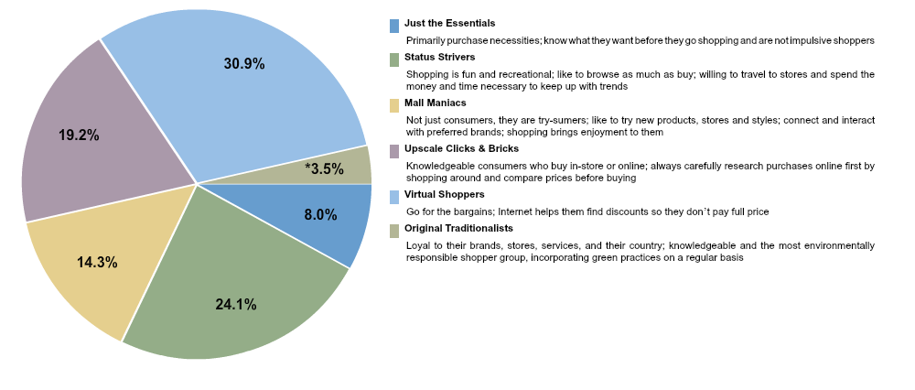
Persuadable Audience: Adults 21-29
Shopping Attitudes
Primarily Virtual Shoppers but Status Strivers is a close second which makes them prime to persuade into buying higher priced items.

Slide 34
Persuadable Audience: Adults 21-29
Shopping Attitudes
 | Spirit Drinkers 21-29 Index | Spirit Drinkers 21-29 Vertical Percent
ATTITUDES (ABOUT SHOPPING)- AGREE A LOT: WHEN I SHOP I USUALLY VISIT A VARIETY OF STORES | 113 | 20.4%
ATTITUDES (ABOUT SHOPPING)- AGREE A LOT: I AM USUALLY WILLING TO SHOP AT NEW STORES | 108 | 14.4%
ATTITUDES (ABOUT SHOPPING)- AGREE A LOT: I USUALLY HEAD RIGHT FOR THE CLEARANCE RACK WHEN I ENTER A STORE | 115 | 18.9%
SHOPPING-REFER ALWAYS: IN-STORE SAMPLES | 132 | 12.6%
SHOPPING-REFER ALWAYS: FREE STANDING DISPLAYS WITH PRODUCT | 106 | 11.2%
Looking for discounts when shopping as well as variety.

Slide 35
Persuadable Audience: Adults 21-29
Brand Loyalty
Not brand loyal; saving money is more important. They will change brands for the sake of variety.
 | Spirit Drinkers 21-29 Index | Spirit Drinkers 21-29 Vertical Percent
ATTITUDES(ABOUT SHOPPING)- ANY DISAGREE: REGARDLESS OF PRICE, IT IS IMPORTANT TO HAVE THE BRAND I LIKE | 110 | 37.5%
SHOP BEHAVIOR-ANY AGREE: I BUY UNKNOWN BRANDS TO SAVE MONEY | 110 | 33.6%
SHOP BEHAVIOR-ANY AGREE: WHEN IN THE STORE, I OFTEN BUY AN ITEM ON THE SPUR OF THE MOMENT | 116 | 43.7%
SHOP BEHAVIOR-ANY AGREE: I LIKE TO CHANGE BRANDS OFTEN FOR THE SAKE OF VARIETY AND NOVELTY | 120 | 22.5%

Slide 36
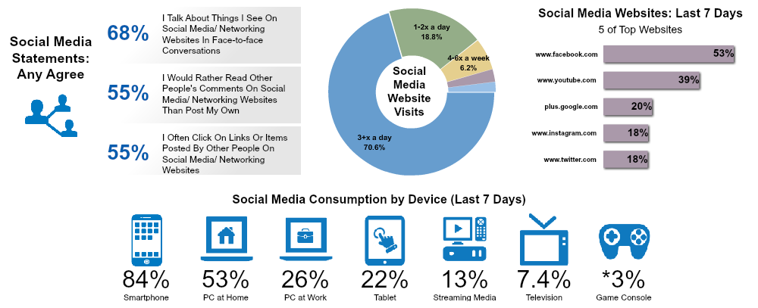
Persuadable Audience: Adults 21-29
Social Media Profile
Extremely high percent check social media 3x or more a day; They are discussing they things they see online in person.

Slide 37
Social Media
Persuadable Audience: Adults 21-29
 | Spirit Drinkers 21-29 Index | Spirit Drinkers 21-29 Vertical Percent
ATTITUDES (SOCIAL MEDIA) - AGREE A LOT: I TALK ABOUT THINGS I SEE ON SOCIAL MEDIA/ NETWORKING WEBSITES IN FACE-TO-FACE CONVERSATIONS | 198 | 28.8%
ATTITUDES (SOCIAL MEDIA) - AGREE A LOT: I LIKE TO FOLLOW MY FAVORITE BRANDS OR COMPANIES ON SOCIAL MEDIA/ NETWORKING WEBSITES | 243 | 15.2%
ATTITUDES (SOCIAL MEDIA) - AGREE A LOT: I WOULD RATHER READ OTHER PEOPLE'S COMMENTS ON SOCIAL MEDIA/ NETWORKING WEBSITES THAN POST MY OWN | 141 | 19.1%
ATTITUDES (SOCIAL MEDIA) - AGREE A LOT: I PAY ATTENTION TO RATINGS AND REVIEWS POSTED ONLINE BY OTHER CONSUMERS | 182 | 16.0%
Not as engaging as Primary Audience; prefer to observe rather than engage.

Slide 38
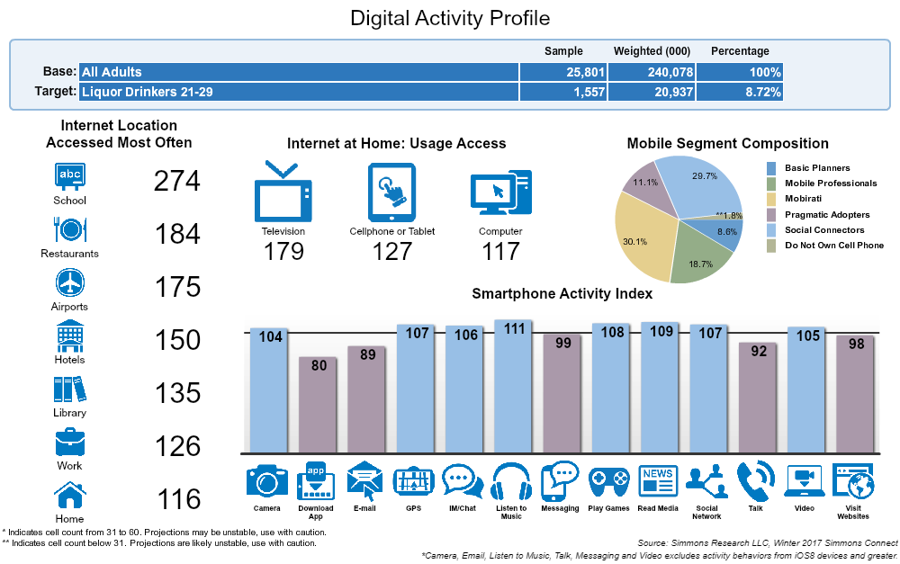
Persuadable Audience: Adults 21-29
Digital Activity
Mobirati
Represent the mobile generation; grew up with cell phones and can’t imagine life without them; cell phone are a central part of their everyday life.
Social Connectors Communication is central in their lives; cell phones allow them to keep up to date with friends and social events and serve as the bridge to their social world.

Slide 39
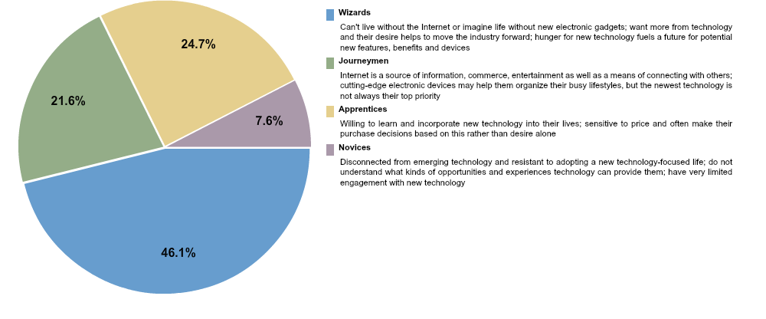
Persuadable Audience: Adults 21-29
Technology Adaptation
Almost 50% are Wizards meaning they cannot live without the internet.

Slide 40
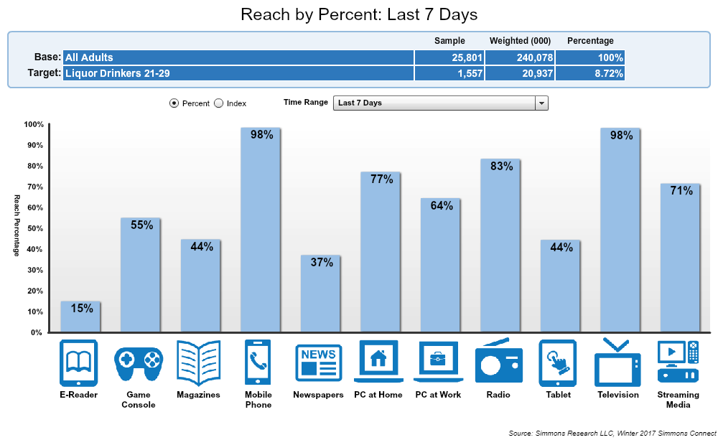
Persuadable Audience: Adults 21-29
How Do We Reach Them?
More time on mobile phone than any other device so any messaging needs to be formatted for mobile. Also very high percent and time for streaming media.

Slide 41
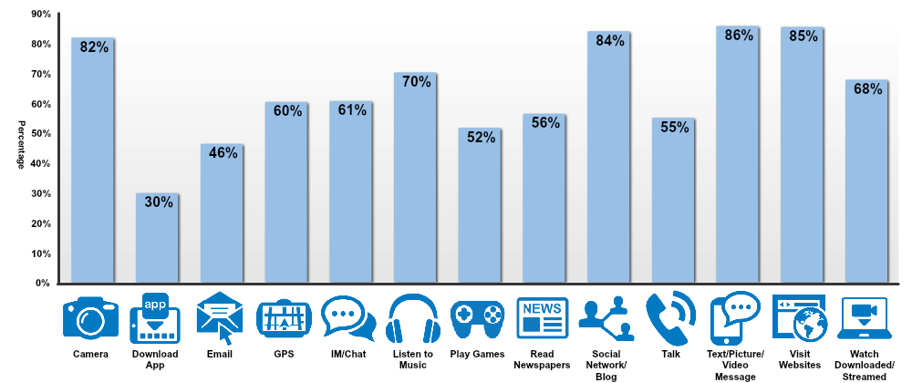
Persuadable Audience: Adults 21-29
How Are They Using Their Smartphones?
App downloads are less than any other audience. Using Mobile to visit Websites and Stream media as well as GPS.

Slide 42
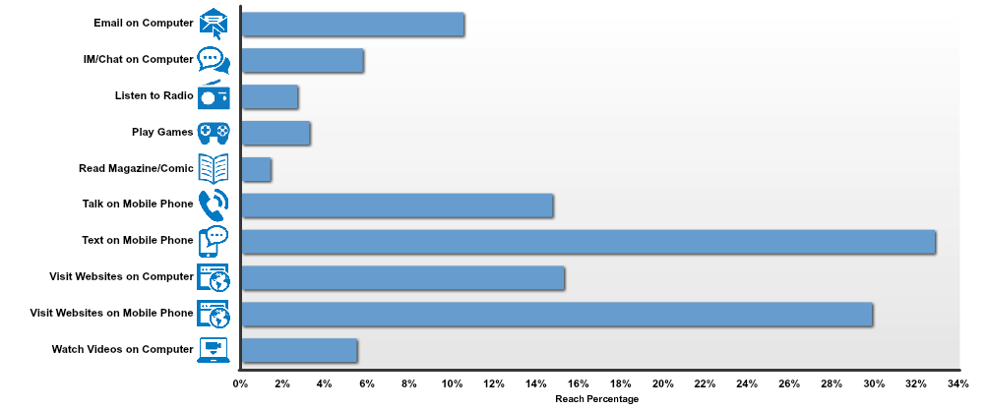
Persuadable Audience: Adults 21-29
Activity While Watching TV
Using multiple devices so necessary to have cross channel strategy.
Again, note that they are on their mobile phone, looking at websites. Important that ABC sites are mobile optimized and active on social media.

Slide 43
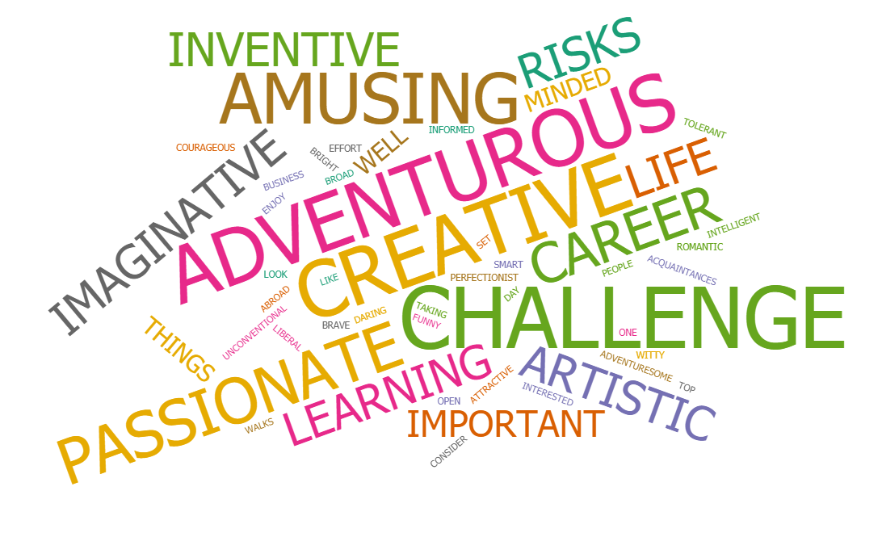
Persuadable Audience: Adults 21-29
High index in emotional messaging! Young, free, unconventional, persuadable, and aspirational.

Slide 44
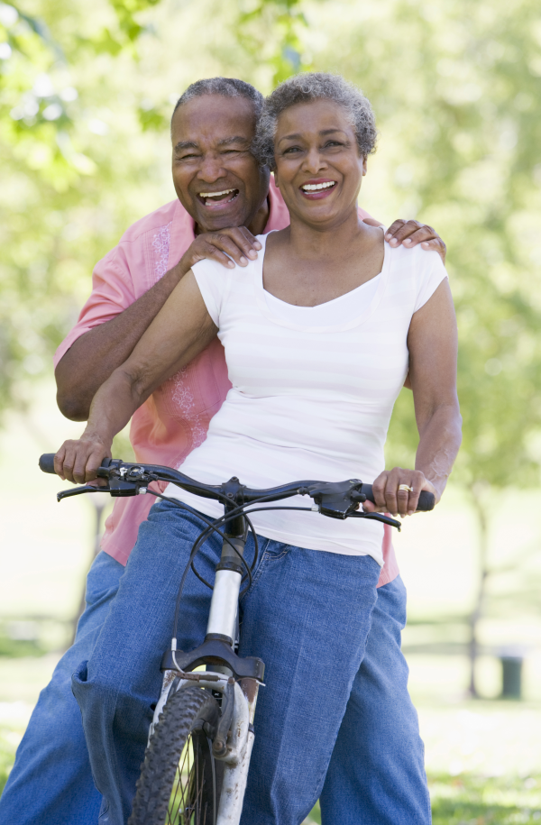
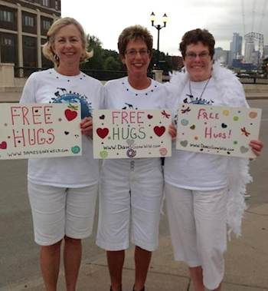
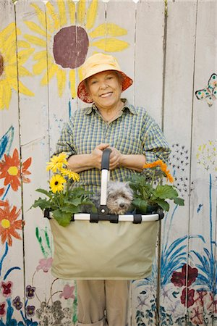

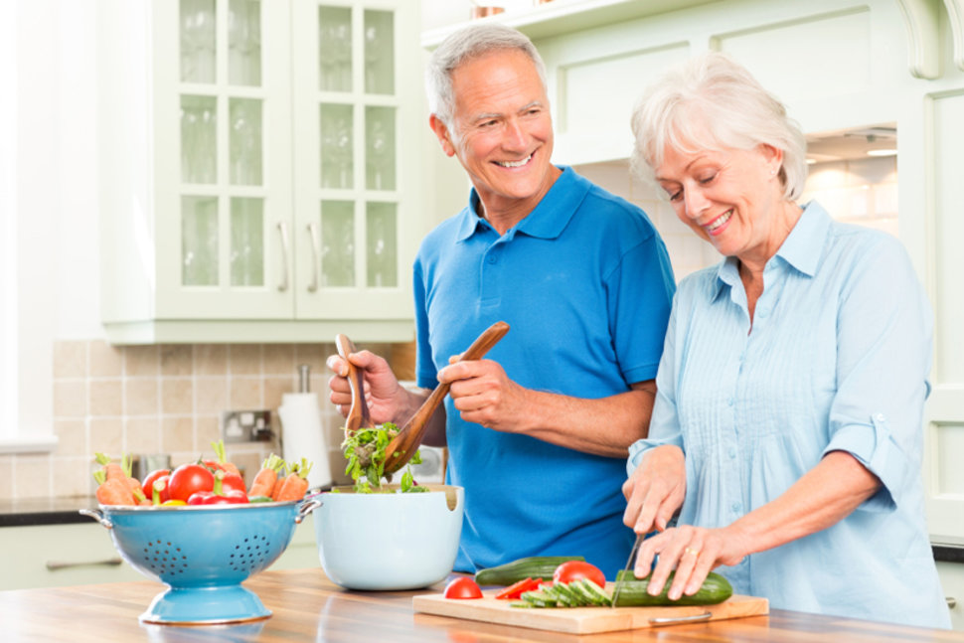

Adults/50-64 22.9% of spirit drinkers
Set and Secure Audience

Slide 45
Key Findings: 50-64 is your greatest opportunity to:
Set and Secure: Adults 50-64
They are brand loyal
They know what they want
Have some disposable income
Willing to spend more to get what they want

Slide 46
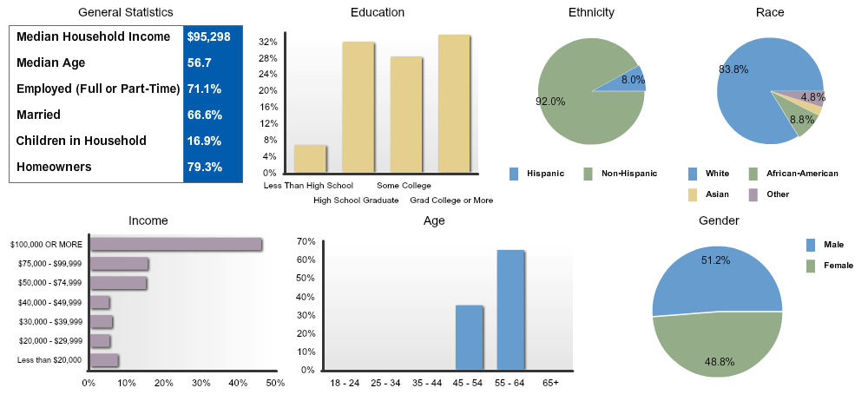
Set and Secure: Adults 50-64
Demographics

Slide 47
Messaging – Who Are They?
Set and Secure: Adults 50-64
 | Spirit Drinkers 50-64 Index | Spirit Drinkers 50-64 Vertical Percent
SELF-CONCEPTS - AGREE A LOT: TRUSTWORTHY, COMPETENT, RELIABLE | 108 | 57.3%
SELF-CONCEPTS - AGREE A LOT: KIND, GOOD-HEARTED, WARMHEARTED, SINCERE | 102 | 45.7%
SELF-CONCEPTS - AGREE A LOT: SOCIABLE, FRIENDLY, CHEERFUL, LIKEABLE | 104 | 32.7%
ATTITUDES (GENERAL) - AGREE A LOT: I AM INTERESTED IN INTERNATIONAL EVENTS | 119 | 16.7%
ATTITUDES (GENERAL) - AGREE A LOT: I AM INTERESTED IN OTHER CULTURES | 108 | 22.3%
ATTITUDES (GENERAL) - AGREE A LOT: I AM GOOD AT FIXING THINGS | 119 | 25.5%
ATTITUDES (GENERAL) - AGREE A LOT: I AM AN OPTIMIST | 115 | 27.6%
ATTITUDES (GENERAL) - AGREE A LOT: I CONSIDER MYSELF TO BE A SPIRITUAL PERSON | 104 | 33.7%
ATTITUDES (GENERAL) - AGREE A LOT: I LIKE TO UNDERSTAND ABOUT NATURE | 115 | 36.7%
ATTITUDES (GENERAL) - AGREE A LOT: I CONSIDER MYSELF TO BE A CREATIVE PERSON | 111 | 29.6%
Consider themselves to be trustworthy, sincere, good-hearted. Very different self concepts than other audiences.

Slide 48
Messaging – Priorities & Future
Set and Secure: Adults 50-64
 | Set and Secure Audience Adults 50-64 Index | Set and Secure Audience Adults 50-64 Vertical Percent
ATTITUDES (GENERAL) - AGREE A LOT: I LOOK AT THE WORK I DO AS A CAREER RATHER THAN JUST AS A JOB | 114 | 24.6%
ATTITUDES (GENERAL) - AGREE A LOT: I ENJOY SPENDING TIME WITH MY FAMILY | 104 | 66.0%
ATTITUDES (GENERAL) - AGREE A LOT: IT IS IMPORTANT TO CONTINUE LEARNING NEW THINGS THROUGHOUT YOUR LIFE | 108 | 61.3%
ATTITUDES (GENERAL) - AGREE A LOT: IT IS IMPORTANT TO BE WELL-INFORMED ABOUT THINGS | 110 | 45.6%
ATTITUDES (GENERAL) - AGREE A LOT: I AM WILLING TO VOLUNTEER MY TIME FOR A GOOD CAUSE | 106 | 32.4%
ATTITUDES (GENERAL) - AGREE A LOT: FAMILY LIFE IS THE MOST IMPORTANT THING TO ME | 105 | 52.5%
ATTITUDES (SOCIAL INTRCTION)-AGREE A LOT: I LIKE TO LEARN ABOUT THINGS, EVEN IF THEY DO NOT SEEM RELEVANT AT THE TIME | 105 | 29.3%
ATTITUDES (SOCIAL INTRCTION)-AGREE A LOT: I ENJOY KEEPING IN TOUCH WITH MY FRIENDS AND ACQUAINTANCES | 105 | 37.7%
ATTITUDES (SOCIAL INTRCTION)-AGREE A LOT: I HAVE A GENUINE INTEREST IN THE PEOPLE WHOM I MEET | 104 | 25.0%
Work is still important but family life is the more important to them.

Slide 49
Messaging – What They Love To Do
Set and Secure: Adults 50-64
 | Spirit Drinkers 50-64 Index | Spirit Drinkers 50-64 Vertical Percent
LEISURE ACTIVITIES/HOBBIES-LAST 12 MOS: BARBECUING | 128 | 49.9%
LEISURE ACTIVITIES/HOBBIES-LAST 12 MOS: COOKING FOR FUN | 113 | 40.4%
LEISURE ACTIVITIES/HOBBIES-LAST 12 MOS: GARDENING | 144 | 44.3%
LEISURE ACTIVITIES/HOBBIES-LAST 12 MOS: GO TO A BEACH/LAKE | 116 | 46.9%
LEISURE ACTIVITIES/HOBBIES-LAST 12 MOS: LISTENING TO MUSIC | 107 | 71.2%
LEISURE ACTIVITIES/HOBBIES-LAST 12 MOS: READING BOOKS | 108 | 53.3%
ATTITUDES (TRAVEL) - AGREE A LOT: I PREFER TRAVELING IN THE U.S. AS OPPOSED TO TRAVELING TO FOREIGN COUNTRIES | 116 | 32.5%
ATTITUDES (GENERAL) - AGREE A LOT: I PREFER TO SPEND A QUIET EVENING AT HOME THAN TO GO OUT | 101 | 32.7%
ATTITUDES (GENERAL) - AGREE A LOT: I ENJOY ENTERTAINING PEOPLE IN MY HOME | 109 | 24.3%
Enjoy entertaining and doing quiet activities at home.

Slide 50
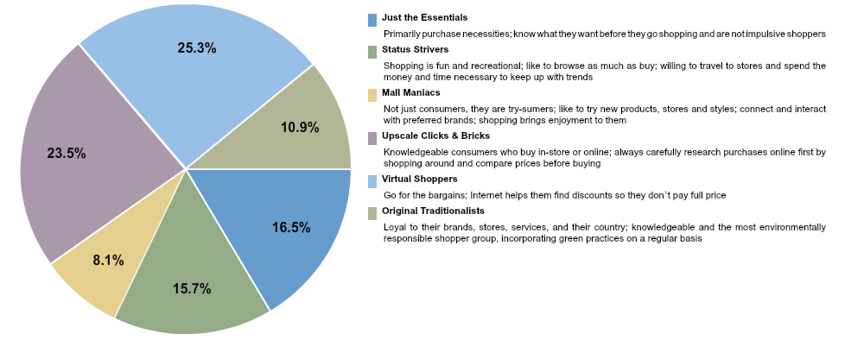
Set and Secure: Adults 50-64
Shopping Attitudes
Knowledgeable shoppers. Both Virtual and Upscale Clicks & Bricks are both known for doing their research before they buy.

Slide 51
Shopping Attitudes
Set and Secure: Adults 50-64
 | Liquor Drinkers 50-64 Index | Liquor Drinkers 50-64 Vertical Percent
ATTITUDES (GENERAL) - AGREE A LOT: IT IS IMPORTANT THAT A COMPANY ACTS ETHICALLY | 118 | 55.1%
ATTITUDES (GENERAL) - AGREE A LOT: IT’S WORTH PAYING EXTRA FOR QUALITY GOODS | 108 | 22.4%
ATTITUDES (GENERAL) - AGREE A LOT: I DECIDE WHAT I WANT BEFORE I GO SHOPPING | 107 | 27.5%
ATTITUDES (ABOUT SHOPPING)- AGREE A LOT: I USUALLY ONLY SHOP AT MY FAVORITE STORES BECAUSE I KNOW THEY HAVE THE BRANDS I LIKE | 101 | 31.5%
ATTITUDES (ABOUT SHOPPING)- AGREE A LOT: A STORE’S ENVIRONMENT CAN MAKE A DIFFERENCE IN WHETHER I SHOP THERE | 107 | 34.1%
ATTITUDES (ABOUT SHOPPING)- AGREE A LOT: I USUALLY ONLY GO SHOPPING WHEN I HAVE TO BUY SOMETHING I REALLY NEED | 103 | 33.6%
ATTITUDES (ABOUT SHOPPING)- AGREE A LOT: I PREFER TO GO SHOPPING ALONE | 112 | 23.0%
ATTITUDES (ABOUT SHOPPING)- AGREE A LOT: WHEN SHOPPING, I JUST GET WHAT I NEED AND LEAVE | 101 | 23.7%
ATTITUDES (ABOUT SHOPPING)- AGREE A LOT: I BUY GOODS PRODUCED BY MY OWN COUNTRY WHENEVER I CAN | 124 | 27.5%
ATTITUDES (ABOUT SHOPPING)- AGREE A LOT: EVEN THOUGH I DON’T NEED IT RIGHT NOW, I WOULD BUY MORE OF A PRODUCT, IF IT WAS ON SALE | 105 | 18.0%
SHOP BEHAVIOR- AGREE A LOT: I ALWAYS LOOK OUT FOR SPECIAL OFFERS | 106 | 22.3%
SHOPPING-REFER ALWAYS: SIGNS ON MERCHANDISE RACKS OR SHELVES | 118 | 15.7%
SHOPPING-REFER ALWAYS: STORE BROCHURES/FLYERS | 121 | 23.2%
They shop only when they need to buy something. They know what they want. How a company behaves is important to them so messaging around P&E may benefit this audience.

Slide 52
Brand Loyalty
Set and Secure: Adults 50-64
 | Spirit Drinkers 50-64 Index | Spirit Drinkers 50-64 Vertical Percent
SHOP BEHAVIOR-ANY DISAGREE: I LIKE TO CHANGE BRANDS OFTEN FOR THE SAKE OF VARIETY AND NOVELTY | 117 | 48.7%
SHOP BEHAVIOR-ANY AGREE: I DO NOT BUY UNKNOWN BRANDS MERELY TO SAVE MONEY | 113 | 39.3%
SHOP BEHAVIOR-ANY AGREE: I ALWAYS LOOK FOR THE BRAND NAME ON THE PACKAGE | 108 | 35.9%
ATTITUDES(ABOUT SHOPPING) - ANY AGREE: PRICE ISN’T THE MOST IMPORTANT FACTOR—IT IS GETTING EXACTLY WHAT I WANT | 111 | 44.4%
ATTITUDES(ABOUT SHOPPING) - ANY AGREE: REGARDLESS OF PRICE, IT IS IMPORTANT TO HAVE THE BRAND I LIKE | 108 | 36.2%
Brand Loyal! They know what they want and will pay to get it.

Slide 53
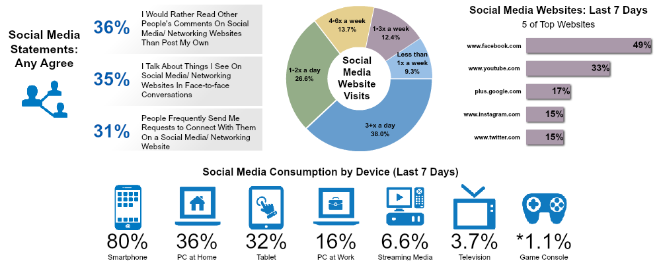
Set and Secure: Adults 50-64
Social Media Profile
Surprisingly high percentage of social media usage 3x a day! Facebook is a potential channel for this audience.

Slide 54
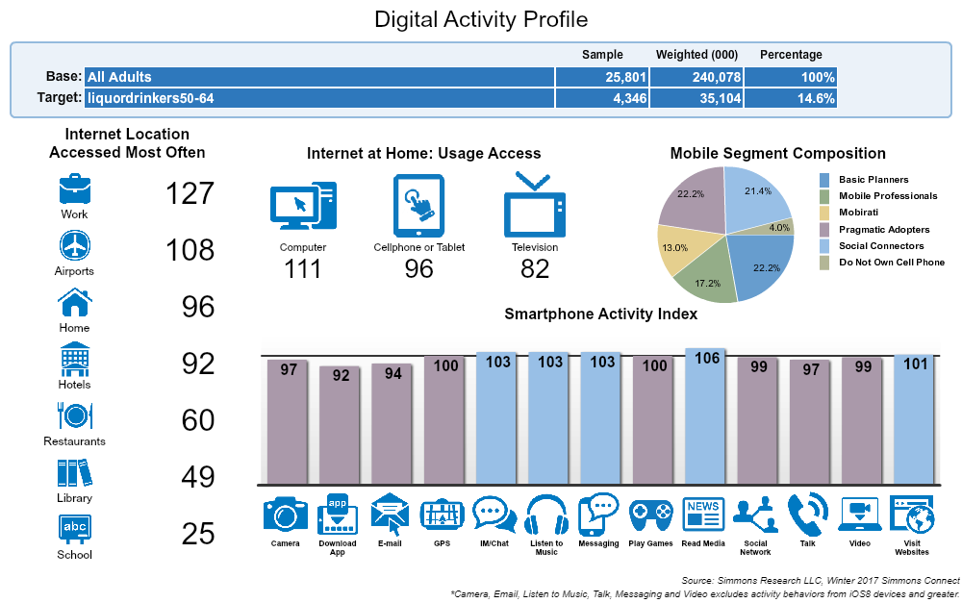
Set and Secure: Adults 50-64
Digital Activity
Basic Planners
Not into cell phones or the world of technology; use their cell phones for the basics; cell phone is just another communication device.
Pragmatic Adopters
Cell phones came to life in their adulthood; still learning there are other things to do with your phone beyond just saying “Hello”; cell phones are more a part of their everyday lives than before but still more functional than entertaining to them
Social Connectors Communication is central in their lives; cell phones allow them to keep up to date with friends and social events and serve as the bridge to their social world.

Slide 55
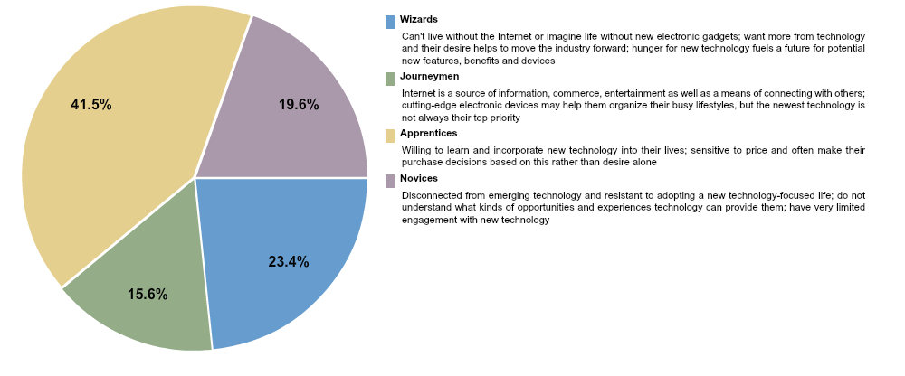
Set and Secure: Adults 50-64
Technology Adaptation
Almost half are Apprentices; Technology has slowly been incorporated into their lives and they are willing to learn; but a large group consider themselves to be tech Wizards.

Slide 56
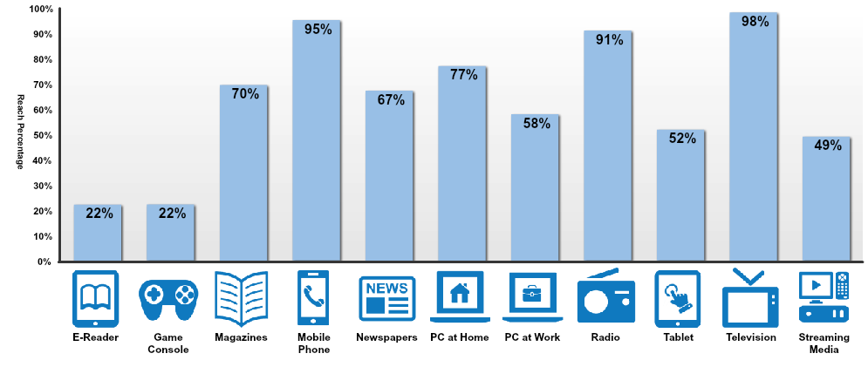
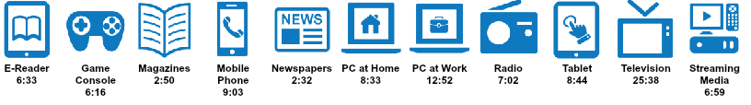
Set and Secure: Adults 50-64
How Do We Reach Them?
A large percent are spending over 9 hours a day on their mobile phones. While over half are spending over 8 hours on their tablets. TV, Radio and Digital are all options for this audience.

Slide 57

Set and Secure: Adults 50-64
How Are They Using Their Smartphones?
Using mobile phones to do just about everything; visiting websites, social media and listening to music. Mobile optimized content is important for this audience.

Slide 58
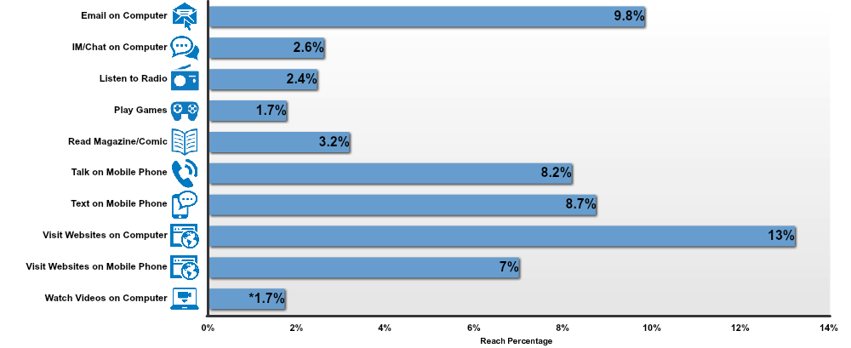
Set and Secure: Adults 50-64
Activity While Watching TV
Highest percentage is 13% which means most in this audience are solely watching TV and not multitasking.

Slide 59
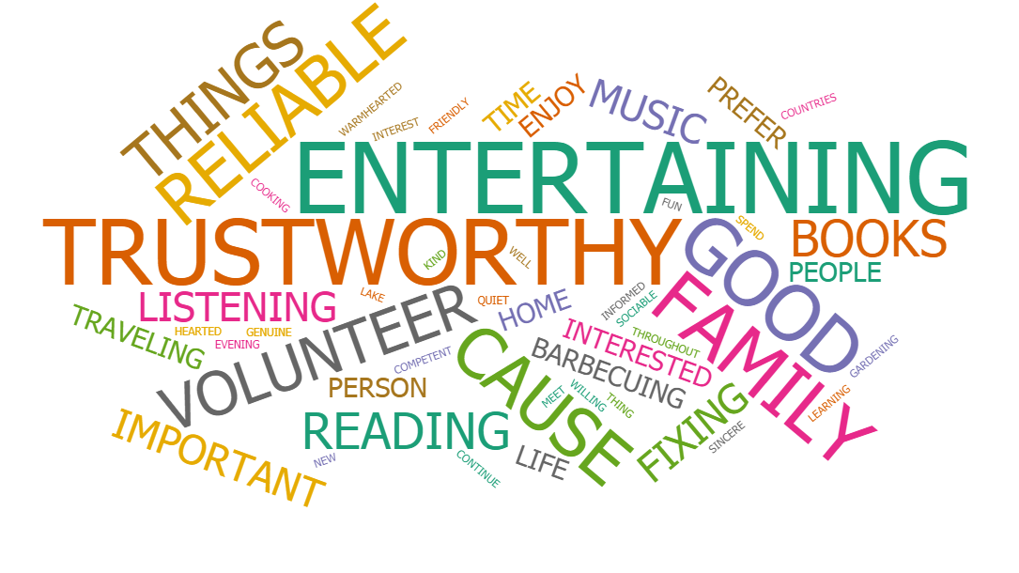
Set and Secure: Adults 50-64
Very well rounded. Priorities have change to things like family and friends.

Slide 60

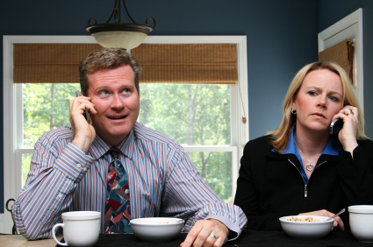

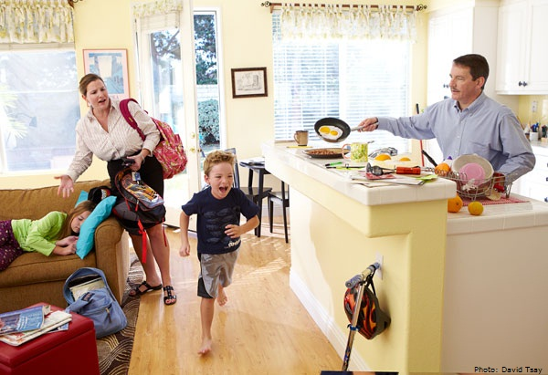

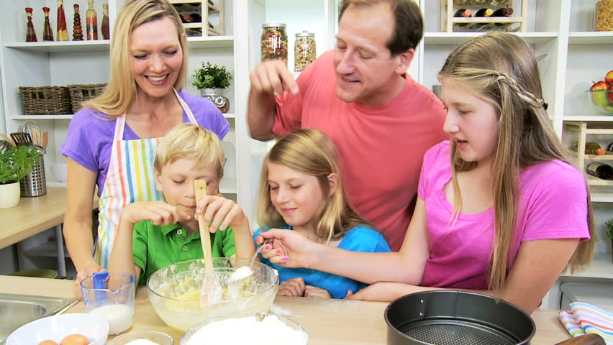
Adults/40-49 23% of spirit drinkers
Too Busy

Slide 61
Too Busy: Adults 40-49
Key Findings: 40-49
They don’t over index or have high percentages in hardly any categories
We are assuming, based on “Last 12 month life events” that they are too busy to spend time on “extra” activities

Slide 62
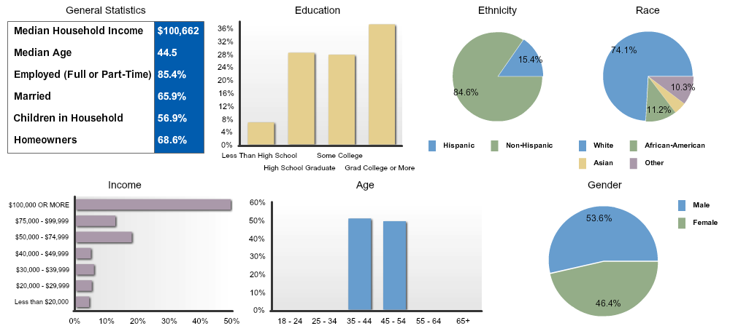
Too Busy: Adults 40-49
Demographics

Slide 63
Messaging – Who Are They?
Too Busy: Adults 40-49
Not a high percentage or over index on any self concepts; they’re adventurous, passionate, and intelligent.
 | Spirit Drinkers 40-49 Index | Spirit Drinkers 40-49 Vertical Percent
ATTITUDES (GENERAL) - AGREE A LOT: I ENJOY ENTERTAINING PEOPLE IN MY HOME | 101 | 22.5%
ATTITUDES (SOCIAL INTRCTION)-AGREE A LOT: I AM ADVENTUROUS | 106 | 17.2%
SELF-CONCEPTS - AGREE A LOT: AFFECTIONATE, PASSIONATE, LOVING, ROMANTIC | 106 | 34.5%
SELF-CONCEPTS - AGREE A LOT: INTELLIGENT, SMART, BRIGHT, WELL-INFORMED | 102 | 30.5%

Slide 64
Messaging – What They Love To Do
Too Busy: Adults 40-49
 | Spirit Drinkers 40-49 Index | Spirit Drinkers 40-49 Vertical Percent
LEISURE ACTIVITIES/HOBBIES-LAST 12 MOS: BARBECUING | 130 | 50.7%
LEISURE ACTIVITIES/HOBBIES-LAST 12 MOS: BOARD GAMES | 117 | 36.0%
LEISURE ACTIVITIES/HOBBIES-LAST 12 MOS: CARD GAMES | 109 | 40.5%
LEISURE ACTIVITIES/HOBBIES-LAST 12 MOS: COOKING FOR FUN | 117 | 41.7%
LEISURE ACTIVITIES/HOBBIES-LAST 12 MOS: GO TO A BEACH/LAKE | 130 | 52.5%
LEISURE ACTIVITIES/HOBBIES-LAST 12 MOS: LISTENING TO MUSIC | 109 | 72.8%
Over indexed by 30 on barbecuing and going to the beach/lake. They enjoy entertaining and group activities. Perfect to promote cocktails.

Slide 65
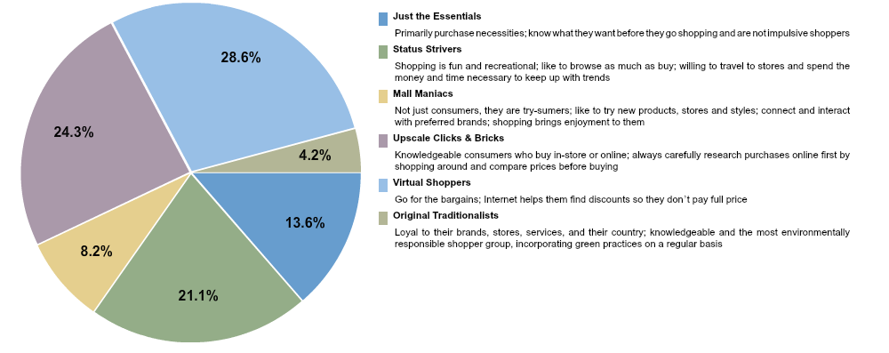
Too Busy: Adults 40-49
Shopping Attitudes
Three primary groups; Virtual Shoppers, Upscale Clicks & Bricks, and Status Strives.

Slide 66
Shopping Attitudes
Too Busy: Adults 40-49
 | Spirit Drinkers 40-49 Index | Spirit Drinkers 40-49 Vertical Percent
ATTITUDES (GENERAL) - AGREE A LOT: IT IS IMPORTANT THAT A COMPANY ACTS ETHICALLY | 99 | 46.0%
ATTITUDES (ABOUT SHOPPING)- AGREE A LOT: FOR RELATIVELY EXPENSIVE ITEMS, I’LL SHOP AT DIFFERENT STORES TO MAKE CERTAIN I GET THE BEST PRICE | 108 | 34.0%
ATTITUDES (ABOUT SHOPPING)- AGREE A LOT: A STORE’S ENVIRONMENT CAN MAKE A DIFFERENCE IN WHETHER I SHOP THERE | 104 | 33.1%
ATTITUDES (ABOUT SHOPPING)- AGREE A LOT: I OFTEN USE THE INTERNET TO HELP PLAN MY SHOPPING TRIPS | 123 | 12.6%
SHOPPING-REFER ALWAYS: PROMOTION OR DISPLAY AT END OF AISLE | 127 | 9.7%
SHOPPING-REFER ALWAYS: SIGNS ON MERCHANDISE RACKS OR SHELVES | 101 | 13.5%
SHOPPING-REFER ALWAYS: STORE BROCHURES/FLYERS | 112 | 21.5%
Believe a store’s environment makes a difference. Even with disposable income they look for the best price.

Slide 67
Brand Loyalty
Too Busy: Adults 40-49
Still an audience not stuck on particular brands. May still be persuaded to higher priced brands.
 | Spirit Drinkers 40-49 Index | Spirit Drinkers 40-49 Vertical Percent
SHOP BEHAVIOR-ANY AGREE: I DO BUY UNKNOWN BRANDS MERELY TO SAVE MONEY | 115 | 35.2%
SHOP BEHAVIOR-ANY DISAGREE: I ALWAYS LOOK FOR THE BRAND NAME ON THE PACKAGE | 106 | 31.9%

Slide 68

Too Busy: Adults 40-49
Social Media Profile
50% checking social media 3x a day and a large group are using YouTube. Video Messaging will be useful for this group

Slide 69
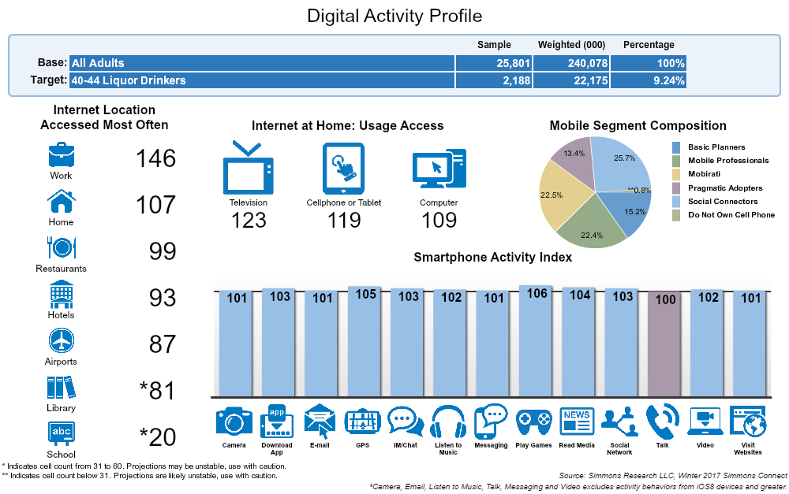
Too Busy: Adults 40-49
Digital Activity
Mobirati
Represent the mobile generation; grew up with cell phones and can’t imagine life without them; cell phone are a central part of their everyday life.
Mobile Professionals
Multiple feature users; cell phones help them keep up with their professional life in addition to their personal life; more likely to own a smart phone; cell phone has become their all-in-one device for their communication and information needs
Social Connectors Communication is central in their lives; cell phones allow them to keep up to date with friends and social events and serve as the bridge to their social world.

Slide 70
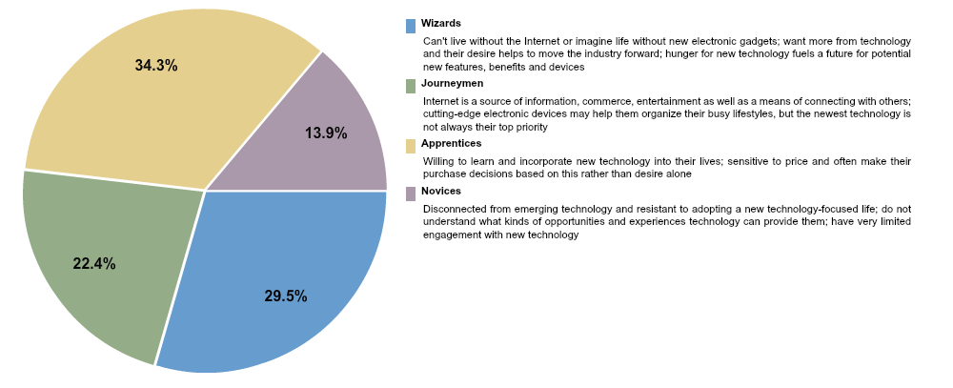
Too Busy: Adults 40-49
Technology Adaptation
A good mix of all four groups

Slide 71


Too Busy: Adults 40-49
How Do We Reach Them?
Large number using mobile phone or over 12 hours a day. Over 50% streaming media for almost 8 hours a day.

Slide 72

Too Busy: Adults 40-49
How Are They Using Their Smartphones?
Using their phones to watch streamed media and social media.

Slide 73

Too Busy: Adults 40-49
Activity While Watching TV
Multitaskers. Almost 20% are either texting, on their computer, or on their phone while watch TV.

Slide 74

Too Busy: Adults 40-49
Not too much energy to put into external activity. Very busy with life!

Slide 75
Similarities Between Audiences

Slide 76
Similarities Between Audiences
Social Media
All visit social media websites 3X a day more than any other category
48% or more visited Facebook in the last 7 Days
35% of more visited YouTube in the last 7 days
80% or more have consumed social media on their mobile device in the last 7 days

Slide 77
Technology Segmentation
Similarities Between Audiences
21-39:
Majority are Wizards: Can’t live without or imagine life without new electronic gadgets; want more from technology and their desire helps to move the industry forward; hunger for new technology fuels a future for potential new features, benefits and devices.
40-64:
Majority are Apprentices: Willing to learn and incorporate new technology into their lives; sensitive to price and often make their purchase decisions based on this rather than desire alone.

Slide 78
Shopping and Brands
Similarities Between Audiences
21-49: They all agree that they buy unknown brands to save money
There were no Shopping Attitudes similar amongst 3 or more audiences
The largest group for all shoppers in retail segmentation were Virtual Shoppers: They go for the bargains; internet helps them find discounts so they don’t pay full price.

Slide 79
Messaging - What They Love To Do
Similarities Between Audiences
All Audiences:
Barbecuing
Going to a beach/Lake
Entertaining people in their home

Slide 80
Messaging - Priorities & Future
Similarities Between Audiences
21-39 & 50-64:
Agree it is important to continue learning new things throughout your life
Agree that they like to learn about things, even if they do not seem relevant at the time

Slide 81
Messaging -Who They Are
Similarities Between Audiences
21-49 View themselves as;
Adventurous
Affectionate, Passionate, Loving, Romantic
Intelligent, Smart, Bright, Well Informed

Slide 82
Beer and Wine Consumers
We repeated our methodology steps 1 & 2 for both Beer and Wine Drinkers in Virginia. We found that in almost all areas there were significant similarities and not enough variances to quantify a statistical difference.

Slide 83




Beer/Wine Comparison
There is a slight skew in gender and age.
Wine Drinkers
Beer Drinkers

Slide 84
Conclusions
All audiences are heavy mobile users
Older audiences are much more tech savvy then most people think
Their primary social media channel is Facebook with YouTube in a close second
All audiences are multi device users
Messaging to these audiences will be very different
A multi channel strategy is imperative

